Slide 1
Theoretical introduction

Slide 2
DSPs and other processors
Top goal is to be fast; at least fast enough to make utter and thorough calculation between two consecutive data sampling
Not only higher clock freq. can make us more expeditious, but smart architecture can do it as well
Separated code and data memory (many from that)
Many parallel buses
MAC (Multiply and Accumulate)
Extended ALU
Supports many kind of indirect addressing
Dedicated hardware for implementing circular buffer

Slide 3
Report / Documentation
Measurement environment
Instruments, devices, software, etc.
Types, ID-s, versions, etc.
What do we measure?
Most germane description for the reader to identify
How do we measure?
Short and apt determination of methods
Presentation of the results
Interpretation of the results
Conclusion(s)
Avoid filler words and stuffing text!

Slide 4
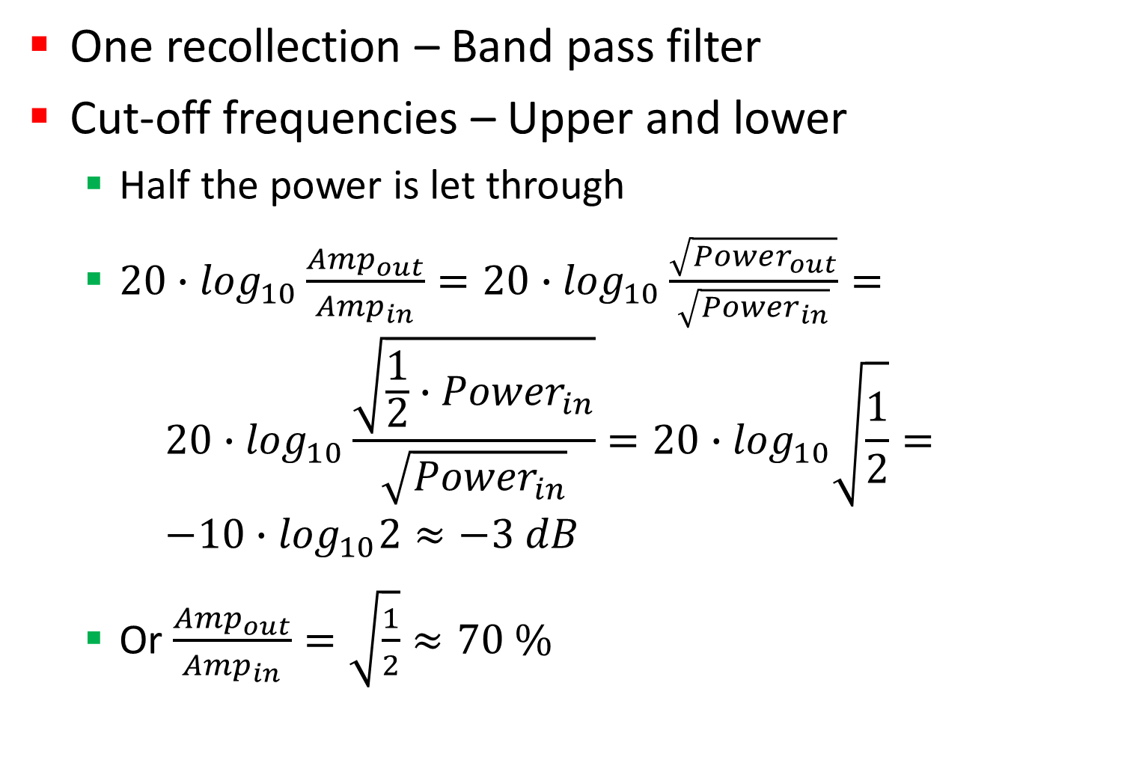
Filters
One recollection – Band pass filter
Cut-off frequencies – Upper and lower
Half the power is let through
$20∙\log_{10}\frac{{Amp}_{out}}{{Amp}_{in}}=20∙\log_{10}\frac{\sqrt{{Power}_{out}}}{\sqrt{{Power}_{in}}}=$ $20∙\log_{10}\frac{\sqrt{\frac{1}{2}∙{Power}_{in}}}{\sqrt{{Power}_{in}}}=20∙\log_{10}\sqrt{\frac{1}{2}}=$ $−10∙\log_{10}2≈−3 dB$
Or $\frac{{Amp}_{out}}{{Amp}_{in}}=\sqrt{\frac{1}{2}}≈70 \%$

Slide 5
Sketch of a filter characterisics
Attenuation
0 dB
-3 dB
Lower cut-off
Upper cut-off
Freq.

Slide 6
Identify filter characteristics
Methode #1
Manually adjust the input signal’s frequency from a choosen low freq. up to a high limit freq by a choosen step and observe the amp. Of the filtered signal relative to the input signal
Methode #2
Parametrise a chirp signal (sweep) and study the FFT of the output signal

Slide 7
0th Task
As we saw finding a good board and cables is not so evident
Before continuing the exercises in the syllabus:
Make sure that you have a good board and two working cable
In order to have that run the basic project „BlackFin_Frame” (copies the input data to the output)
If you managed it, let me know!

Slide 8
Main Tasks of the 2nd Laboratory
First 60 minutes
Finish what you were not able to finish on the first occasion
Last 120 minutes
Work with the document named „Design and implementation of digital filters”
There will be not enough time to finish everything. Concentrate on 6.1 FIR filter and on 6.2 IIR filter routine only
Try to generate a sine wave with the DSP and visualize it on the oscilloscope

Slide 9
Generate sine wave and sum of sines
Frequency: 2025 Hz
Start with the project: BlackFin_FIR_fract
Check whether it works, in order to know the integrity of the cables and the development board
How does the sine function’s argument looks like in this digital environment?
Consult the manual of CrossCore C/C++ Compiler man.
Find a sine function for fract
Conversions between float/double and fract
Constants for the extrema for data types
Consideration: harmonics
Generate sawtooth, square wave, triangular sign

